Slide 1


We are proud members of:
Introducing the
Corporate Fiber & Materials Benchmark

Slide 2

What we will talk about today
About benchmarking
The run up to this year’s benchmark
What’s coming next
PHOTO: ECOALF
Notes:
The context of benchmarking is improving
Explain about asking questions via chat - answered in blocks
show video

Slide 3
Tell us about you
How much do you know about the Textile Exchange benchmarking program?
  I know nothing
  I know a little
  I know a lot about it
  My company has been involved but I’m new to the program
PHOTO: ECOALF
Notes:
The context of benchmarking is improving
Explain about asking questions via chat - answered in blocks
show video

Slide 4
Tell us about you
What is your main role in your company?
  sustainability
  communications/marketing
  designer/product development
  buying
  company owner
  other (let us know in the chat box!)
PHOTO: ECOALF
Notes:
The context of benchmarking is improving
Explain about asking questions via chat - answered in blocks
show video

Slide 5
Tell us about you
Does your company have a fiber/materials sustainability strategy?
  no
  under development
  yes
PHOTO: ECOALF
Notes:
The context of benchmarking is improving
Explain about asking questions via chat - answered in blocks
show video

Slide 6





We Drive Industry Transformation
We work closely with our members and leaders across the textile sector to accomplish five principal goals.
Drive an increase in the adoption of preferred fibers and materials.
Increase integrity throughout the value chain via the adoption of standards and certifications.
Enable collective impact and action across the industry.
Raise awareness about the positive, meaningful changes accomplished.
Use the Sustainable Development Goals as a common vocabulary and reporting framework.
Commitments
Standards
Benchmarking
Peer Learning
By accomplishing these goals, we will catalyze transformative change that will result in a more sustainable, responsible textile industry.
Notes:
As you know, Textile Exchange is a non-profit with a mission to make the textile industry more sustainable.
We work with our members and others to:
1 – Increase the adoption of preferred fibers and materials
2 – Increase the adoption of credible sustainability standards
3 – Help the industry come together to find good solutions, share innovations, and work together
4 – Raise awareness of issues and opportunities to improve
5 – And increasingly, to align our work with the SDGs and provide a reporting framework – through our benchmark program

Slide 7
The Corporate Fiber & Materials Benchmark helps companies systematically measure, manage and integrate a preferred fiber and materials strategy into mainstream business operations.
─
Notes:
Textile Exchange’s focus is to accelerate the uptake of preferred fiber and materials.
This objective is built on the urgency to respond to key risks for the textile industry and the huge opportunity for the industry to play a major role in meeting the 2030 Global Coals (the Sustainable Development Goals). These risks and opportunities are most likely to occur during the production of raw materials.
By creating a benchmark program for companies, Textile Exchange not only measures and reports company and industry progress, but provides strategic direction for the companies that participate. Through program engagement alone, companies embark on a “bench learning” journey, with the support of Textile Exchange staff and fellow participants. The contributing and receiving of knowledge creates a virtuous circle of learning and improving.

Slide 8
“
It is the sourcing of raw materials that is the direct interface between business and nature. Through sustainable sourcing and reconfiguring supply chains, we can help drive change in agriculture, mining, and forestry, and promote regenerative, wildlife-friendly approaches to production.
Dr. Helen Crowley,
Head of Sustainable Sourcing Innovation, Kering

Slide 9

Why benchmark fibers and materials?
https://textileexchange.org/pfm-benchmark/

Slide 10

Benchmarking is rising up the ISEAL agenda.
Defining good practices for credible benchmarking.
Sustainability Benchmarking Good Practice Guide Draft v0.2 for Consultation (first half of 2019)
Scope covers both the benchmarking of standards, and corporate benchmarking programs.
ISEAL aims to:
Contribute a framework and practical set of good practices and considerations for organisations and initiatives considering whether to carry out a benchmarking exercise or develop a benchmarking program.
Publicise existing benchmarking programs as a means to limit the proliferation of benchmarks.
Support increased consistency and strengthening of sustainability benchmarking programs so that they can effectively support better practices and a faster transition to a more sustainable world.
Notes:
ISEAL: Defining good practices for credible benchmarking.
Governments, companies and other stakeholders use voluntary standards or similar sustainability tools to realize more responsible and sustainable supply chains.
Governments, companies and other stakeholders often use benchmarking or recognition processes to assess and qualify standards and similar initiatives.
Benchmarks also rank companies for their sustainability performance.
To improve the quality, transparency and alignment of these processes, ISEAL is consulting on a draft Sustainability Benchmarking Good Practice Guide.
To ensure consistent, accurate and robust benchmarking, ISEAL has developed a practical guide for organisations who commission or carry out sustainability benchmarks. In particular, the guidance aims to support public policy-making and inform policy design, which will help stimulate the development of advanced smart-mix policies for sustainable production and consumption.
This project is supported by the Deutsche Gesellschaft für Internationale Zusammenarbeit (GIZ), on behalf of the Federal Ministry for Economic Cooperation and Development (BMZ).
ISEAL:
ISEAL Benchmarking landing page
Sustainability Benchmarking Good Practice Guide (v0.2)
Benchmarking resources
Opportunities for the CFMB
Textile Exchange is an ISEAL member. We are contributing to the development of the guide, and aim for the CFMB to be recognized by ISEAL as a best in class benchmark program.

Slide 11

Corporate Benchmarking and the Sustainable Development Goals: The rise of the corporate benchmark
Textile Exchange is a member of the World Benchmarking Alliance
The WBA is: “building a movement to measure and incentivize business impact towards a sustainable future that works for everyone”.
Developing benchmarks to compare company performance.
The private sector has a crucial role to play in advancing the SDGs.
To boost company's motivation there needs to be a change in the way that their impact is measured.
Working with a broad group of allies who help the WBA be a successful driver of change.
Founded by the UN Foundation, Index Initiative and Aviva. A number of governments including the UK, Norwegian and Swedish governments are also supporting the WBA.
Priority areas for the WBA:
Food and Agriculture
Gender Equality and Empowerment
Digital Inclusion
Climate and Energy
Seafood
Key ally:

Slide 12
How benchmarks help companies.
1. ─ Benchmarks clarify what societies expect from industries and companies. | 2. ─ Benchmarks clarify where and how companies can contribute to sustainability. | 3. ─ Benchmarks promote a race to the top. | 4. ─ Benchmarks help companies track progress. | 5. ─ Benchmarks promote dialogue and are a proven and effective engagement tool for companies.
World Benchmarking Alliance
Notes:
Benchmarks clarify what societies expect from industries and companies. Companies often deal with a wide range of stakeholders with diverging expectations and priorities. Through an extensive multi-stakeholder consultation process, benchmarks can identify common ground among key stakeholders and build consensus around these expectations. Benchmark methodologies can then translate these expectations into clear metrics, providing companies with a path forward. “Benchmarking helps us understand where the gaps are for us and what stakeholders want us to focus on.”
Benchmarks clarify where and how companies can contribute to sustainability. The potential contribution of an industry to sustainable development is influenced by an industry’s core business and position in the value chain. This both determines and limits the influence of industries and companies. Benchmarks clarify the role of companies in achieving particular SDGs, but also highlight the responsibilities of other stakeholders. This in turn helps companies prioritize action, which maximizes their contribution in a way that is efficient and effective. “You can spend hundreds of millions of dollars on CSR without having much of an impact.” Provided they are robust, credible, and provide a fair and scrutinized analysis, benchmarks are powerful tools to raise awareness on an issue and shape the debate around what industries can do about it.
Benchmarks promote a race to the top. The league tables that are derived from benchmarks leverage the forces of competition to improve corporate performance; leaders are motivated to do more, while laggards are motivated to catch up. The cyclical nature of benchmarks provides companies with a strong incentive to improve and show progress over time. For top-performers, the results can be used as a source of competitive advantage while low rankings can act as a “wake-up call”. Used in the SDG context, this effect could give companies a powerful incentive to improve their sustainability performance and promote alignment with the 2030 Agenda, as well as help reduce the SDG investment gap.
Benchmarks help track progress. The routine issuance of league tables helps to show progress both relative to peers and to societal expectations. “Benchmarking is not just a ranking; it’s also showing the gap.” This kind of exposure allows companies to learn from benchmarks and use them to progress. Benchmarks can bring important added value by informing and defining corporate strategy.
Benchmarks promote dialogue and are a proven and effective engagement tool for companies. Benchmarks build on extensive multi-stakeholder dialogue. “The conversation about what constitutes a good contribution to the SDGs amongst key stakeholders is as important as the benchmark itself. The real value lies in the dialogue that is created before, during and after the benchmark.” Providing all stakeholders with easy-to-use, reliable and comparable information empowers individuals and organizations to exert their full influence to improve corporate sustainability performance. Both investors and civil society frequently use benchmarks and league tables to engage companies and promote corporate change.
https://www.worldbenchmarkingalliance.org/the-five-reasons-benchmarks-work

Slide 13







The Corporate Fiber & Materials Benchmark (CFMB) runs on a trusted technology platform.
The CFMB is powered by Probench, developed and delivered by our technology partners 73Bit. Probench was originally built to power the successful Business In The Community’s suite of benchmarks and indices.
Participants’ Portal:
Secure confidential access
Live survey and embedded guidance material
Library of guidance notes and other useful support tools
Confidential library of company feedback reports
Confidential archive of company survey submissions
Benchmark community noticeboard
Benchmarking programs powered by Probench include:
Notes:
Textile Exchange has been working with the 73Bit team since 2011. Starting with the transition of consumption data collection from excel to Probench.
In 2015, we launched the PFMB program pilot on the Probench platform by developing a benchmarker user portal. Participants register to participate, which gives registered users secure access to the latest survey, guidance notes and other useful support tools. The company portal is also where their confidential feedback reports are [currently] uploaded each year and previous submissions are archived.

Slide 14
Why Benchmark
─

Slide 15
The Corporate Fiber & Materials Benchmark helps companies systematically measure, manage and integrate a preferred fiber and materials strategy into mainstream business operations.
─
Notes:
Textile Exchange’s focus is to accelerate the uptake of preferred fiber and materials.
This objective is built on the urgency to respond to key risks for the textile industry and the huge opportunity for the industry to play a major role in meeting the 2030 Global Coals (the Sustainable Development Goals). These risks and opportunities are most likely to occur during the production of raw materials.
By creating a benchmark program for companies, Textile Exchange not only measures and reports company and industry progress, but provides strategic direction for the companies that participate. Through program engagement alone, companies embark on a “bench learning” journey, with the support of Textile Exchange staff and fellow participants. The contributing and receiving of knowledge creates a virtuous circle of learning and improving.

Slide 16
You know your operations are 10% better than last year.
Great if everyone else is only 5% better.
But what if they are 20% better?
That’s benchmarking.

Slide 17
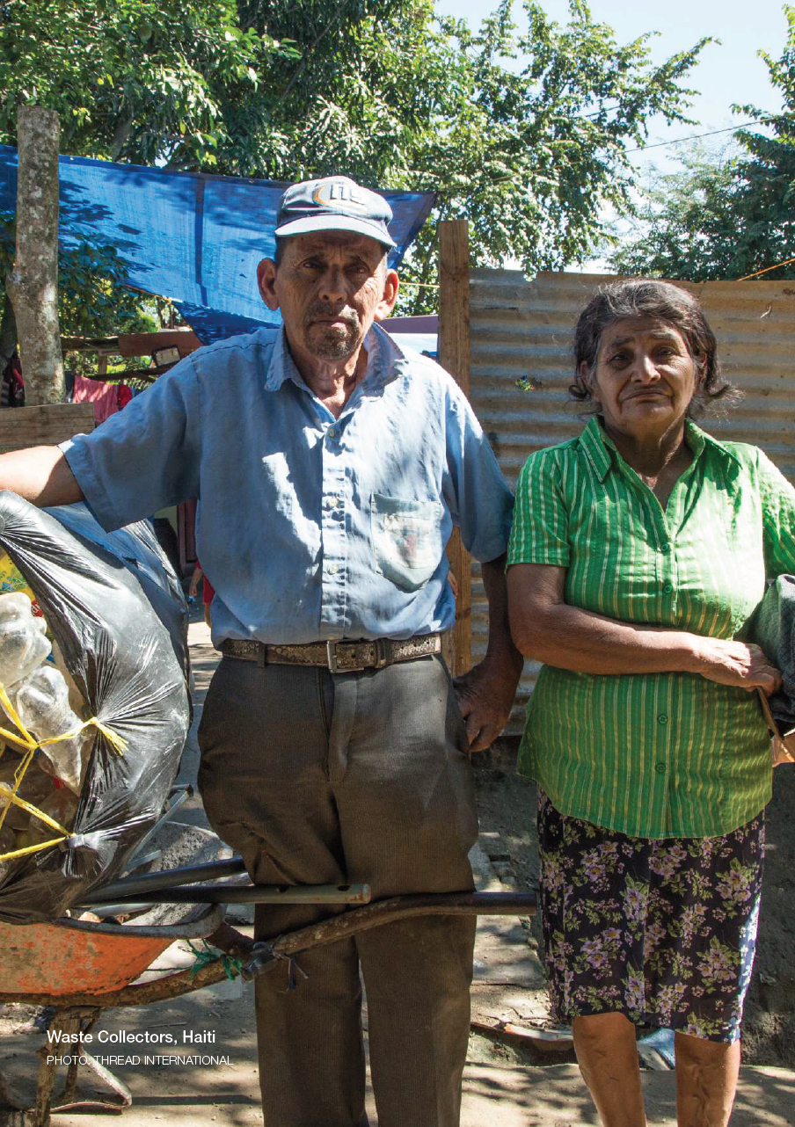
The benchmark supports a company’s transition to a preferred fibers and materials portfolio.
Science-based data is proving that some of the biggest sustainability impacts occur during the growing, extraction and primary processing of raw materials.
Knowing where your materials are coming from is key to assessing and managing supply risks and opportunities.
Setting targets, measuring progress and communicating activities is part of good management and increasingly expected.
The CFMB helps companies:
Build a robust fiber and materials strategy
Manage a portfolio approach to each fiber/material category
Develop or strengthen data gathering and reporting
Track progress year-on-year and against industry peers
Demonstrate leadership
Communicate to staff, board, and other important stakeholders

Slide 18
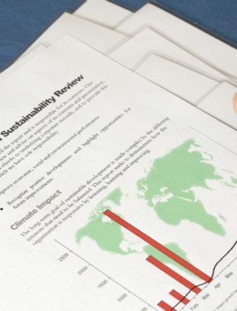
Participating in the CFMB demonstrates a company’s commitment to greater transparency.
There is growing pressure for companies to report out on their activities and for public disclosure of non-financial data.
The CFMB helps companies:
Gather and organize reliable data related to fiber and materials sustainability.
Map fiber and materials related data to other important reporting initiatives (e.g. SAC, SASB).
Your CFMB results can be used in the public domain to show your companies commitment to improvement and leadership.
Communicate to external stakeholders such as investors or analysts.

Slide 19

The CFMB links the textile industry to the Sustainable Development Goals.
The Sustainable Development Goals (SDGs) are universal; equally valid for developed and developing countries, people-centered, planet-sensitive, and measurable.
Most importantly, companies are expected to play a critical role in meeting the Goals.
Companies are starting to align their sustainability strategy with the SDGs and use the SDGs as a common language to promote good business.
The CFMB helps companies:
On their SDG journey
Access a knowledge pool that can be shared within the benchmarking community.
Report out on progress towards the SDGs.

Slide 20
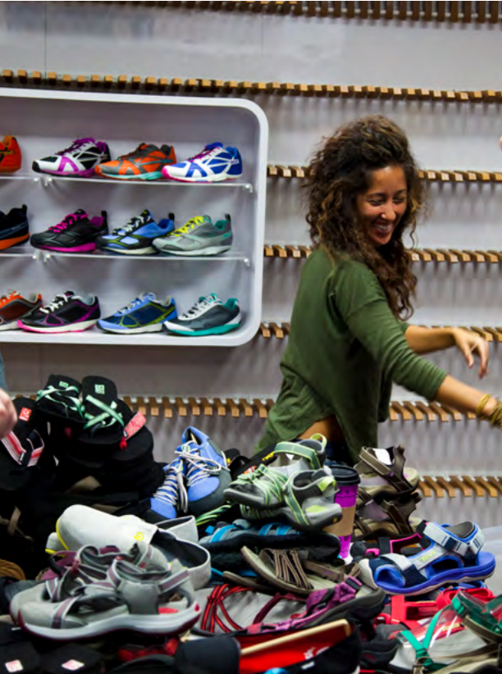
What does my company get from participation?
During the submission period:
Support prior to and during survey completion.
Access to guidance and tools.
Submission review, interactive dialogue, conference call.
Reports and recognition:
Company reports card and display dashboard (confidential).
Public report and recognition (leaderboards, vignettes, visibility)
Consulting services:
Strategy development.
Gap analysis and recommendations.
Company visits, presentations, workshops.
PHOTO: DECKERS
Notes:
Program Services
Survey Support All participants have access to the team and written support during the survey completion period.
Review Process and company visits The PFMB review team carry out a submission review and correspond directly with the company. The goal is 10% in-person visits, 40% phone meetings, and the remaining 50% over email.
Results The PFMB team is available to give general interpretation of a company’s feedback report and answer any questions.
Consulting
Additional support can be arranged and customized to the company’s needs. For example, popular requests include:
Enhanced Gap Analysis A drill down into areas where a company is weakest or where they would like to specifically focus, including our recommendations and examples of best practice gleaned through the program.
Presentations and workshops A pre or post-results visit to your company to better prepare or feedback results in person. Audiences can be sustainability teams, cross-departmental teams, c-suite or board, etc.
Benchlearning
Group learning opportunities beyond the Benchmark is an area we are wanting to develop further. It’s clear from our PFM Working Groups that people are inspired and better equipped through dialogue and interaction.
Opportunities include eLearning webinar series, peer-to-peer “book clubs”, and further integration of the PFMB into existing Working Groups.

Slide 21
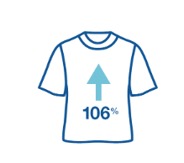
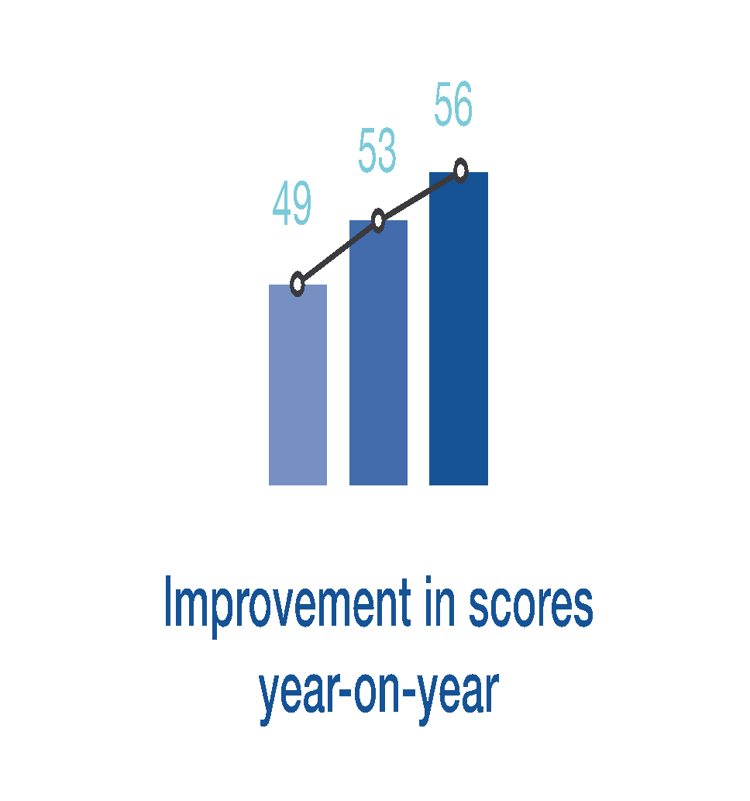
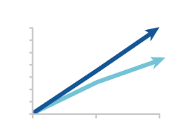
Three years of benchmarking have laid the foundations.
Piloted in 2015, the PFM Benchmark has become the biggest peer-to-peer exercise in the industry.
Increased number of participants since the pilot in 2015. From 71 to 111
(increase of 56%)
Snapshot of 2018 Participants
111 Companies
17 Countries
US$ 1.65 Trillion Est. Turnover
80 Returning Participants
43 Founders Club
31 New Participants
Continuous improvement in scores since the first PFM Benchmark in 2016. From a sector average of 49 in 2016 to 56 in 2018 (growth of 14%).
43 companies participated consecutively across 3 years
(60% of the original 71).
Above: Results from the PFMB Insights Report 2018

Slide 22
Improvements for 2019
─

Slide 23
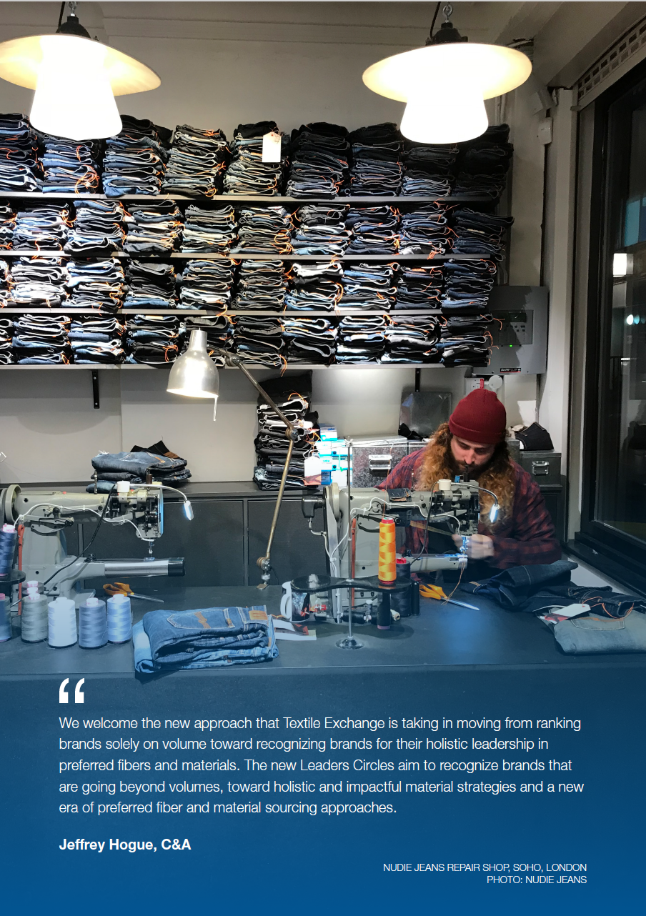


Program Review: Where did we focus?
After 3 years of benchmarking we are making some exciting updates
PRIORITY AREAS UNDER REVIEW:
Harmonizing with other initiatives
Improving data quality
Growing participation
Simplifying and streamlining the survey
More focus on Circularity and the Sustainable Development Goals
Reviewing the definition of “preferred” – deep dive into “preferred manmade cellulosics”
Improving company feedback and public reporting
Building a resilient business model
Program support:
Notes:
PRIORITY AREAS UNDER REVIEW:
Survey – Simplify and rationalize the benchmark framework and question sets to make it easier and more focused.
Harmonization – Aim for greater alignment with other important industry tools such as the SAC BRM Module, SCAP 2020 Commitment, Partnership for Sustainable Textiles (Member Company Roadmaps).
Participation Scope – Outreach to >75% of brand and retail market (by value). Explore a widening of eligibility to include suppliers through a pilot in 2019.
Leaderboards – Move away for volume-based leaderboards towards more holistic PFM Benchmark league tables.
Financial Sustainability – Secure partnerships and build a healthy financial base to invest in program improvements.

Slide 24
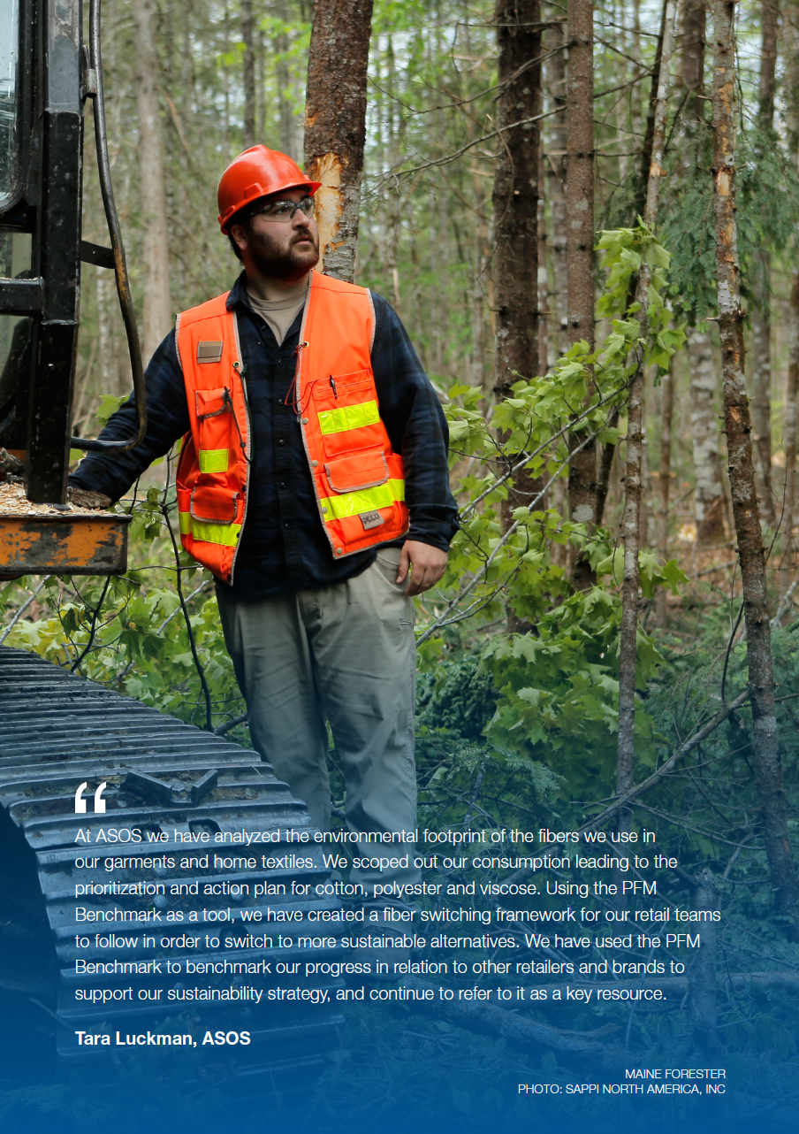










Towards harmonization with others
Dialogue - Open and continued dialogue
Referencing - Tag or reference work done by others
Definitions - Harmonization of key concepts
Aligning - Identifying overlaps, interfaces and differentiation
Collaboration - Improve value and reduce burden
and more
Notes:
The PFMB is currently under review. Alongside the Textile Exchange team members, there is a Steering Group overseeing the more strategic decision-making.
An important part of the CFMB review was mapping our survey against other initiatives as we aim to increase harmonization.
The CFMB is the only benchmark focusing on the overall portfolio fibers and materials but there are linkages to a few other frameworks.
Among the key initiatives we have identified were SAC BRM, Partnership, SCAP… and we also looked at OECD, SASB, ...
SAC is currently also reviewing their Brand and Retailer Module and proposed in their updated version to refer to Textile Exchange… there has not yet been made any final decision but there is the aim for harmonization…
As discussed a big piece of the review is also the development of the Fiber Consumption Calculation Guide which has been initiated by Textile Exchange and is supported by the German Partnership and SCAP… beyond that we have mapped the survey questions or the different frameworks and started to align where possible….
SAC – Brand & Retail Module (BRM)
Partnership for Sustainable Textiles
SCAP / Wrap
Sustainable Cotton Ranking
OECD
SASB
GRI
CDP
UNGC
SBT, GfA 2020 Commitment, Circle Economy, B-Corp and others

Slide 25
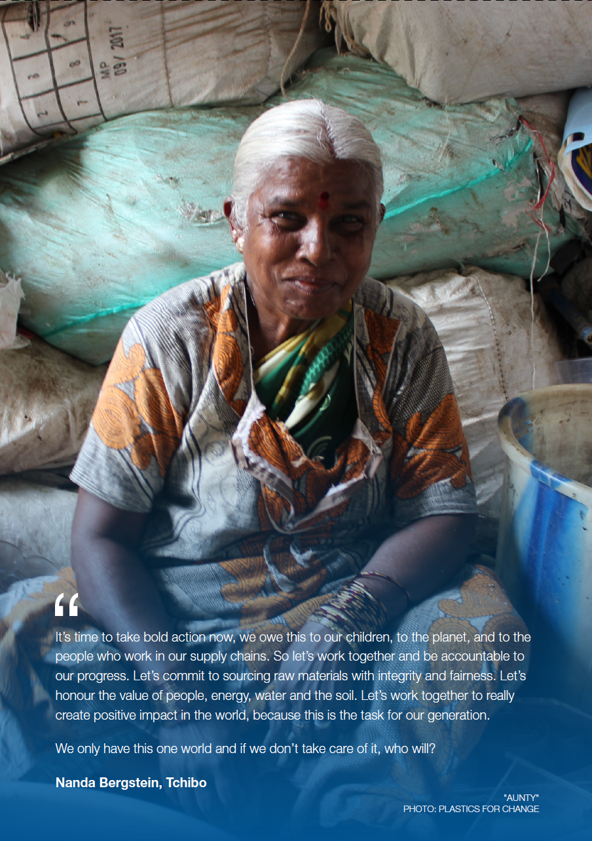

Improving Data Quality
Textile Exchange received questions about the quality and consistency of consumption data submitted by participants, and called for us to find a way to support improvements.
Research launched on Fiber Calculations (current and best practices), methodologies and data integrity systems.
  Over 50 organisations have provided feedback
Aim is to develop a best practices guidance document to encourage consistent measurement throughout industry.
Research conducted with support from:

Slide 26
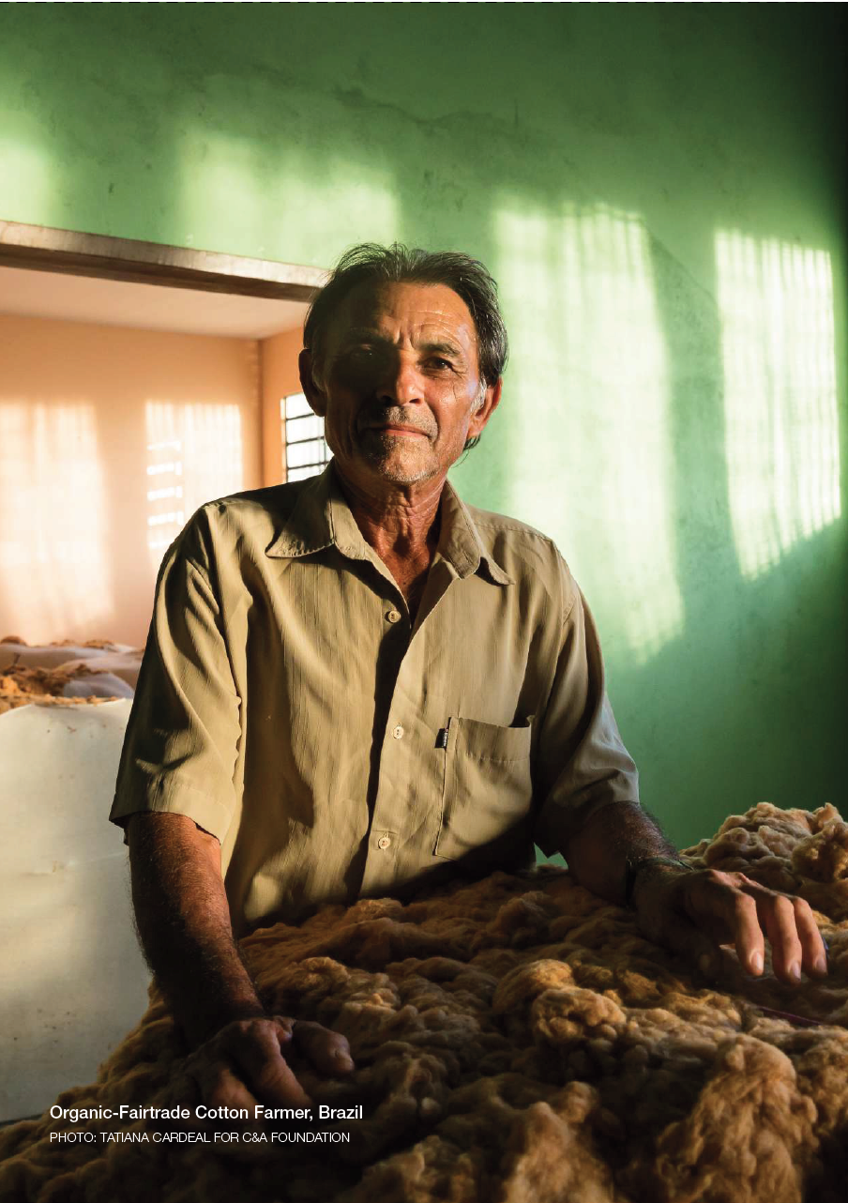
Improving Data Quality
The Fiber Consumption Calculation Guidance Document will:
Support the identification of the most suitable data source from the company’s internal systems
Support the processing of data and sharing of best practice examples
Give recommendations on product integrity systems to collect supplementary information on preferred fibers/materials (supporting accuracy and claims)
Share the methodology by which company-reported consumption is converted into industry totals for the CFMB and leaderboards
Introduce a Fiber Consumption Calculation Metadata Form to increase transparency of calculations.
The Guidance Document & Metadata Form to launch end of April.
PHOTO:TOCMC

Slide 27
Growing participation
Broadening brands and retailer participation
All Textile Exchange member brands and retailers
All previous benchmark participants
All signatories and members of sustainable sourcing initiatives (Sustainable Cotton 2025, rPET Commitment, etc.)
At least 75% of textile and apparel brands by market share
Piloting the program for suppliers
Explore the applicability of the corporate benchmark for others, such as suppliers of fibers/materials
Create a pilot working group made up of different fiber specialists

Slide 28

Simplifying and streamlining the survey
Reducing the number of questions
Consolidating modules and removing repetition
Notes:
There will no longer be modules for each preferred fiber option (e.g. organic cotton or recycled polyester) but there will be one module per fiber type (e.g. cotton).

Slide 29
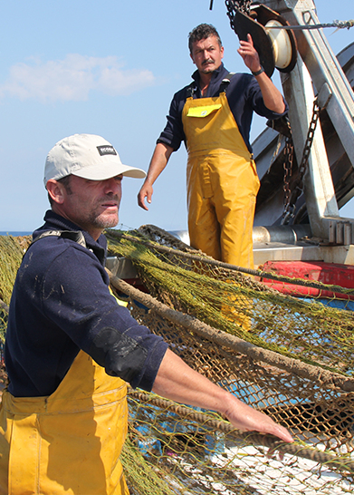
Circularity and the
Sustainable Development Goals
A new module on circularity
A closer look at SDG target setting and progress tracking
Remain aligned with the UNGC
PHOTO: ECOALF

Slide 30
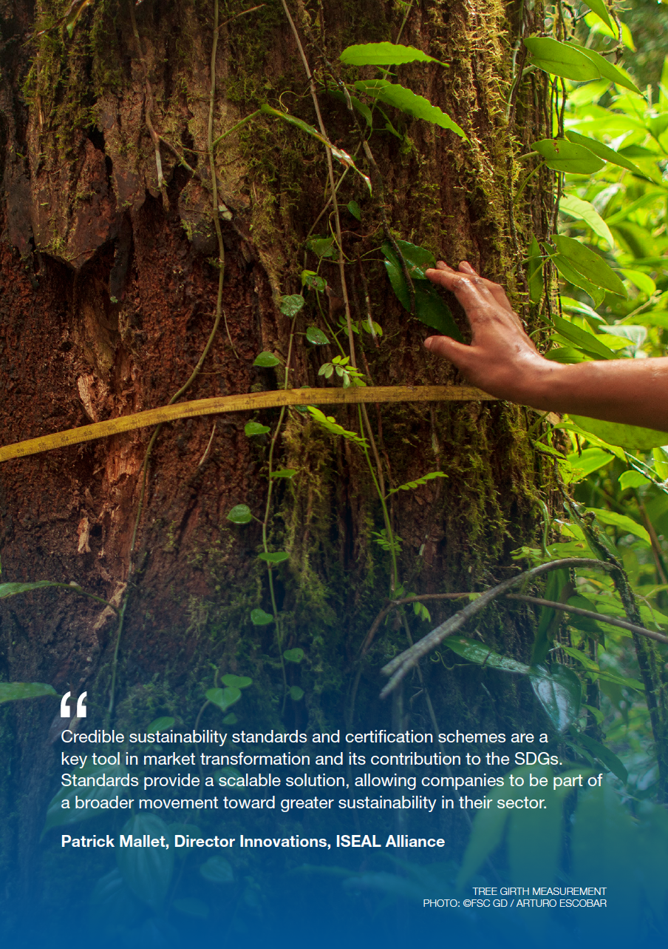
Reviewing the definition of “preferred”
Overall review of “preferred”
Textile Exchange cross-functional team
Ensuring definition is fit-for-purpose for at least the next 3 years
Pre-spin phase (including all processes not just growing)
Alongside review of “preferred” we are reviewing the process for reviewing and the options within a portfolio
Deep dive in manmade cellulosic fibers
Inquiry process with around 20 experts
Building a holistic definition from feedstock to fiber gate
Covering the key MMCFs but also recognizing the growth and innovation in feedstock options.
Notes:
Sustainability is a journey not a destination - and things change over time
The concept of a “PFM” matures and evolves -
We need to ensure that our definition of a “PFM” remains accurate and relevant

Slide 31
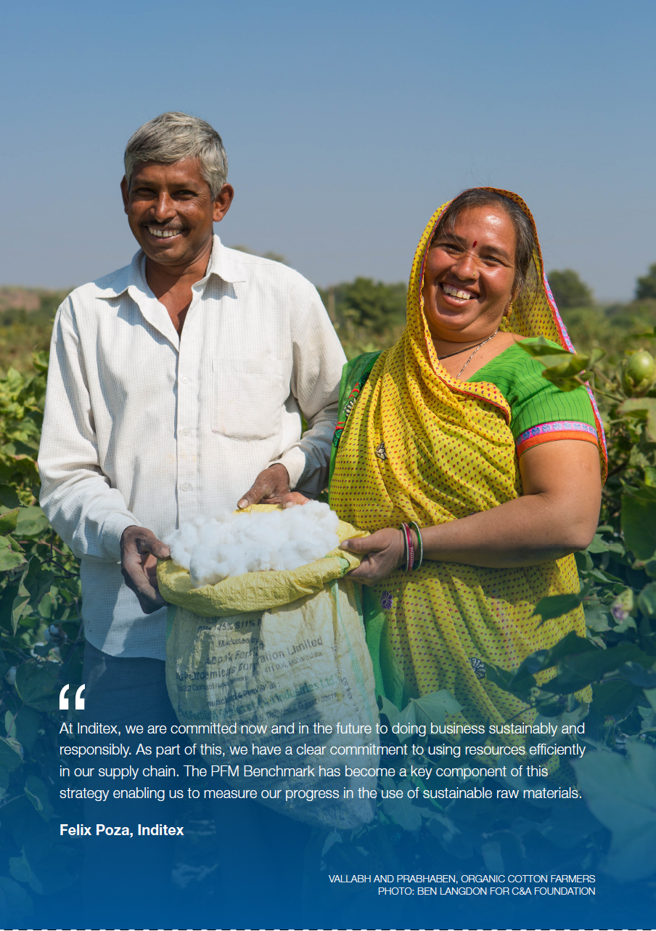
Improving company feedback
and public reporting
Moving from static to interactive - Exploring the different options for display dashboards - for both individual companies and for the public report and leaderboards
Implementing levels of feedback - From basic results to enhanced analytics.
Public reporting of benchmarking results - Exploring different ways to present leaderboards, and more storytelling, possibly linking more to the SDGs.
A move away from volume-based leaderboards - Until now, self-reported volume- based “Top 10s” have been publicly reported. Going forward, we aim to give a more holistic overview of company progress. Data in the public domain will be validated first.

Slide 32
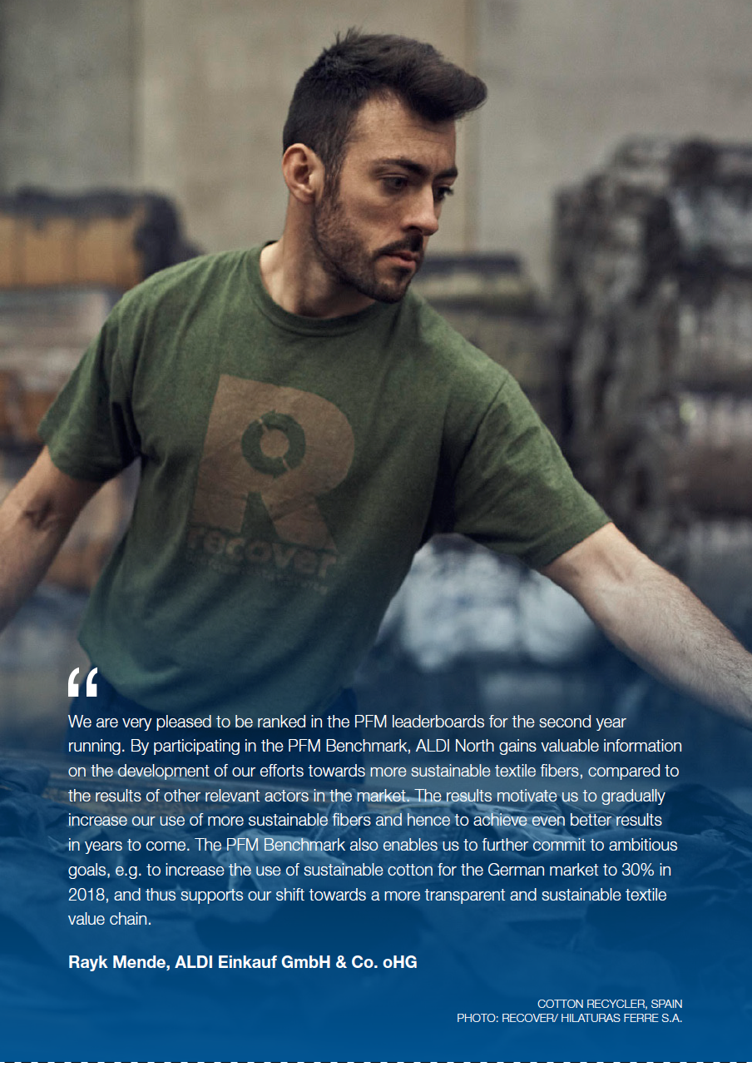
Building a resilient business model
Partnership – Partnerships with companies, investment community, foundations and governments. Fundraising is required now that the program is growing rapidly.
Voluntary participation fee – This year we are introducing a voluntary contribution (based on company size). There will be no financial barrier to participate.
Access to enhanced data and analytics – Payment structure for access to enhanced analytics and visualization of data incl. member benefits.
Consulting – E.g. Supporting companies with strategic development, calculating fiber volumes, gap analysis, etc. Delivering company presentations, workshops, peer learning round tables.
Sponsored publications - Potentially release deep dives into benchmark findings sponsored by partner organizations.
Validation of data in public domain: This year through partnerships with support organizations, and during roll-out of new fiber calculation guidance, the cost of data validation will be absorbed. From 2020, we will be factoring this into the cost of delivering the program.
Notes:
mention the idea of “payment for verification in order to be on the public listings”?
Partnership – Partnerships with companies, investment community, foundations and governments. Fundraising is required now that the program is growing rapidly.
Voluntary participation fee – This year we are introducing a voluntary contribution ($2,500). There should be no financial barrier to participate but also no barrier to contribute to ensuring the program is resourced.
Access to enhanced data and analytics – Payment structure for access to enhanced analytics and visualization of data. Member benefits (see details on next page).
Consulting – E.g. Supporting companies with strategic development, calculating fiber volumes, gap analysis, etc. Delivering company presentations, workshops, peer learning round tables.
Membership – Textile Exchange membership satisfaction/retention and growth.
Sponsored publications - Potentially release deep dives into benchmark findings sponsored by partner organizations.
Sharing of data and analytics – Potentially to company stakeholders e.g. investors, analyzers, other initiatives, etc.

Slide 33
The run up to this year’s benchmark
─

Slide 34
The Framework
I. Strategy and Integration | II. Portfolio Management and Performance | III. Circularity
S1. Leadership | Portfolio overview | CR-1 Circularity Strategy
S2. Responsibilities | Risk Management | CR-2 Reduce
S3. Risk Assessment | Investment | CR-3 Design for Circularity
S4. Goals | Transparency | CR-4 Collection
S5. Customer Engagement | Targets | CR-5 Repair, reuse, resell
S6. Reporting | Uptake | CR-6 Recycle

Slide 35
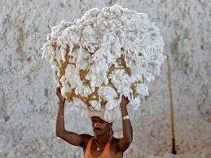



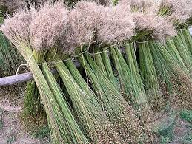

A company’s PFM portfolio is now assessed within fiber categories
Portfolio approach
Building a suite of preferred fibers and materials, from a choice of preferred options, through the consideration of impacts and organizational priorities.
Embedding a strategy that leads to preferred options replacing unsustainable or less sustainable options.
A commitment to the principles of continuous improvement and ensuring options selected result in a positive impact.
Recognizes that one size does not fit all” and allows participants to build their own portfolio based on the PFMs their company is implementing.
COTTON FIBERS | SYNTHETIC FIBERS (Polyester, Nylon) | MANMADE CELLULOSIC FIBERS
ANIMAL FIBERS - WOOL | ANIMAL FIBERS - DOWN | OTHERS (e.g. linen, hemp, leather)
Notes:
Building a suite of preferred fibers and materials, from a choice of preferred options, through the consideration of impacts and organizational priorities.
Embedding a strategy that leads to preferred options replacing unsustainable or less sustainable options.
A commitment to the principles of continuous improvement and ensuring options selected result in a positive impact.
Provided the above approach is taken, the PFM Benchmark recognizes that one size does not fit all” and allows participants to build their own portfolio based on the PFMs their company is implementing.

Slide 36
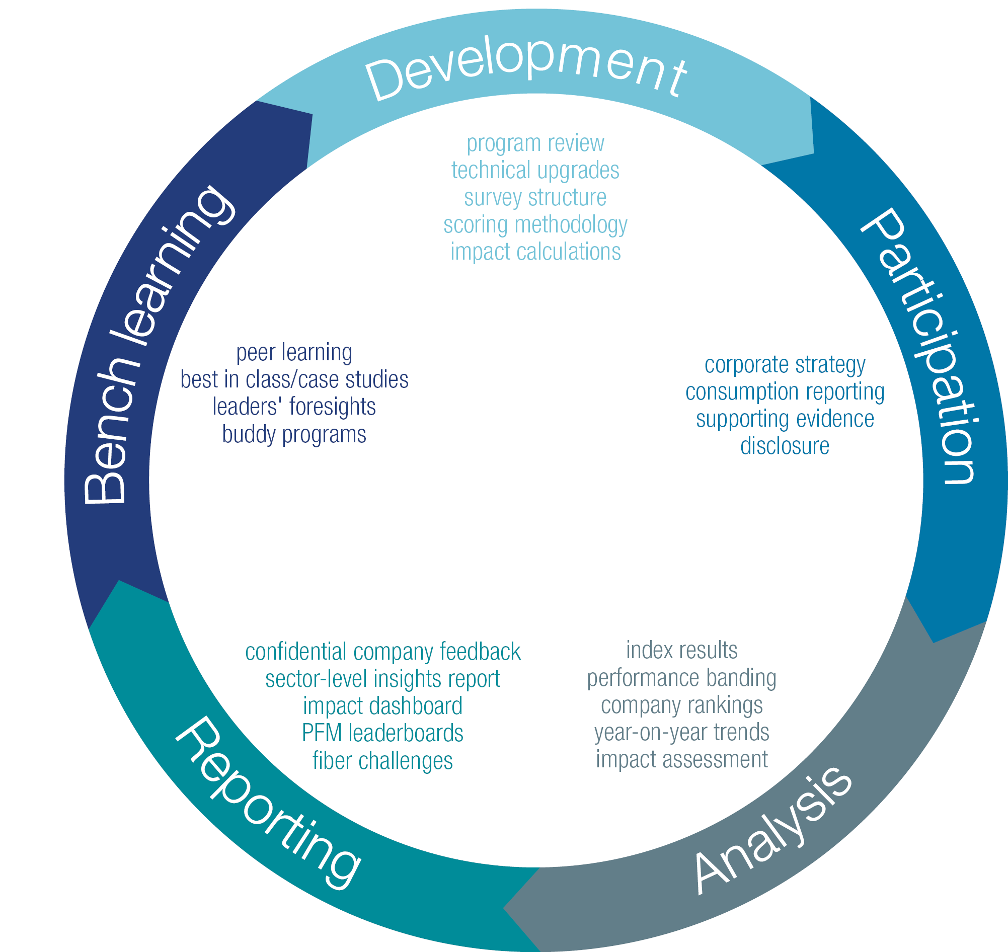
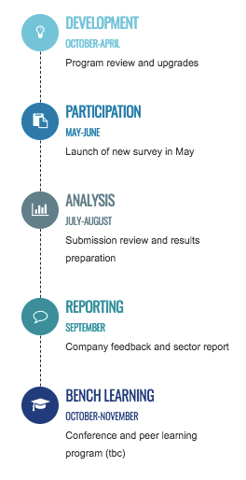
The Corporate Fiber & Materials Benchmark (CFMB) is cyclic with a predetermined window for survey submission
____
WAYS TO ENGAGE
CFMB Program
2025 Sustainable Cotton Challenge
rPET Commitment
SURVEY OPTIONS
Benchmark Survey
What you get: Company Feedback Report
Consumption Tracker (lighter survey option)
What you get Basic progress report
Notes:
WAYS TO ENGAGE
PFM Benchmark All benchmark questions and consumption volumes.
Consumption Tracker Alternative, lighter version, for companies wishing to track progress towards targets.
Sustainable Cotton Challenge Companies committed to sourcing 100% of cotton from more sustainable sources by 2025.
rPET Commitment Companies committed to use of rPET by at least 25% by 2020.

Slide 37
Timeline
May 2019
June 2019
July 2019
August 2019
September 2019
6th
30th
End
Survey submission
Review Process
Feedback reports
Insights report & Leaderboards

Slide 38
Benchmark process
1
Benchmark profile creation
___
Data to prepare for the benchmark
Fiber consumption for the reporting period, by fiber type and preferred fiber
Supplier lists
Documentation relative to fiber certification in the supply chain
2
Benchmark survey completion and submission
3
Verification by Textile Exchange
Verification is based on accuracy, consistency and completeness. Review is followed up with each company.
4
Amendments to submitted survey
Adjustments are made if necessary according to the feedbacks provided in the verification process.
5
Scoring and data compilation
6
Individualized company feedback reports
7
Sector Benchmark Results and Insights Report
Notes:
Hands on webinar on how to complete and submit the survey

Slide 39

Next Webinar
___
Scheduled May 6th 2019 (time and details will be sent soon)
Presentation of the online portal; including new functionalities
Survey questions and submission requirements
Guidance options available
Scoring methodology
PHOTO: NZ Merino
Notes:
Hands on webinar on how to complete and submit the survey

Slide 40




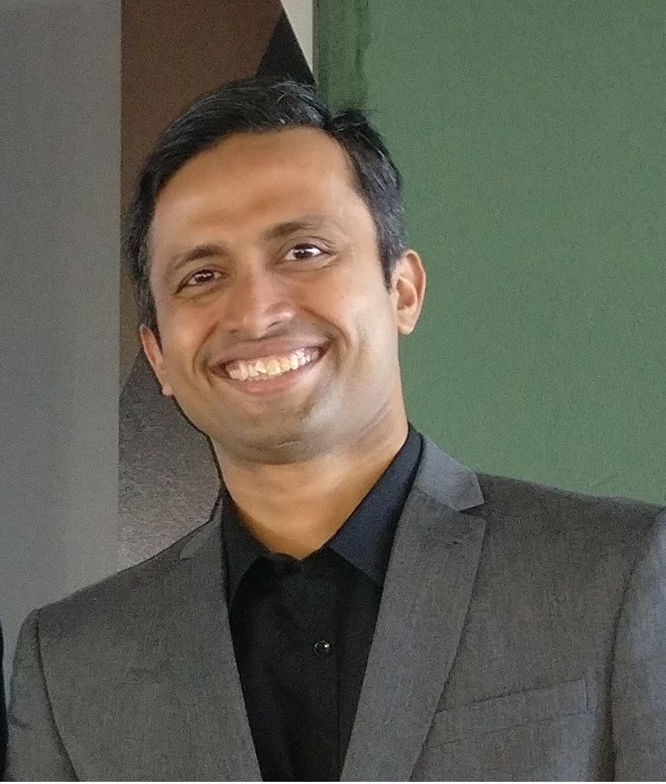
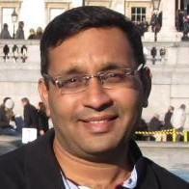
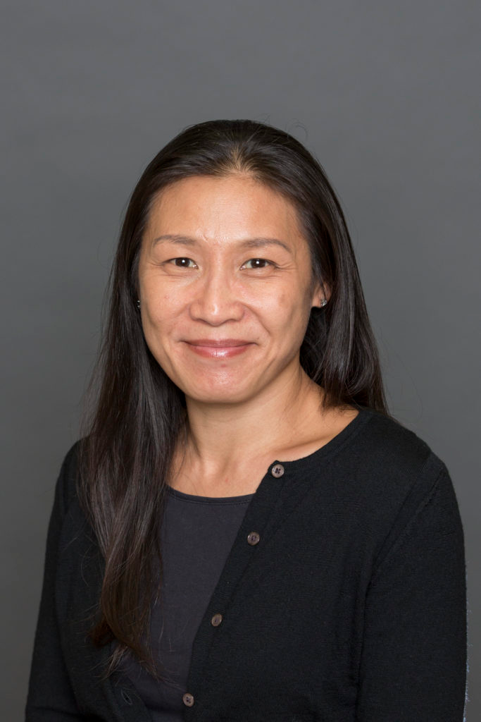
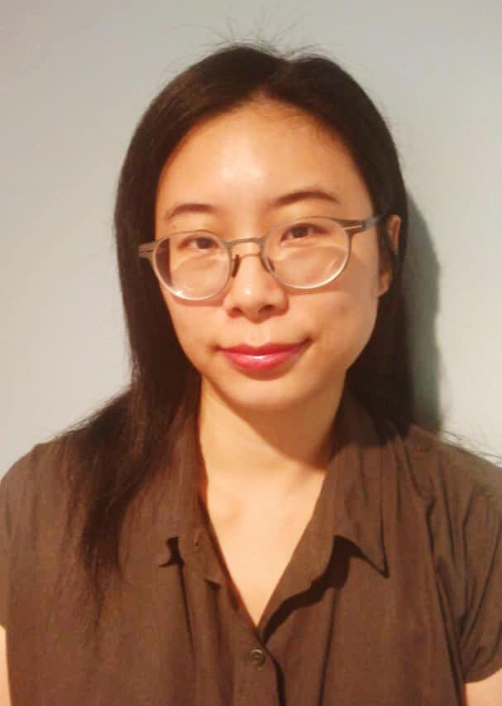


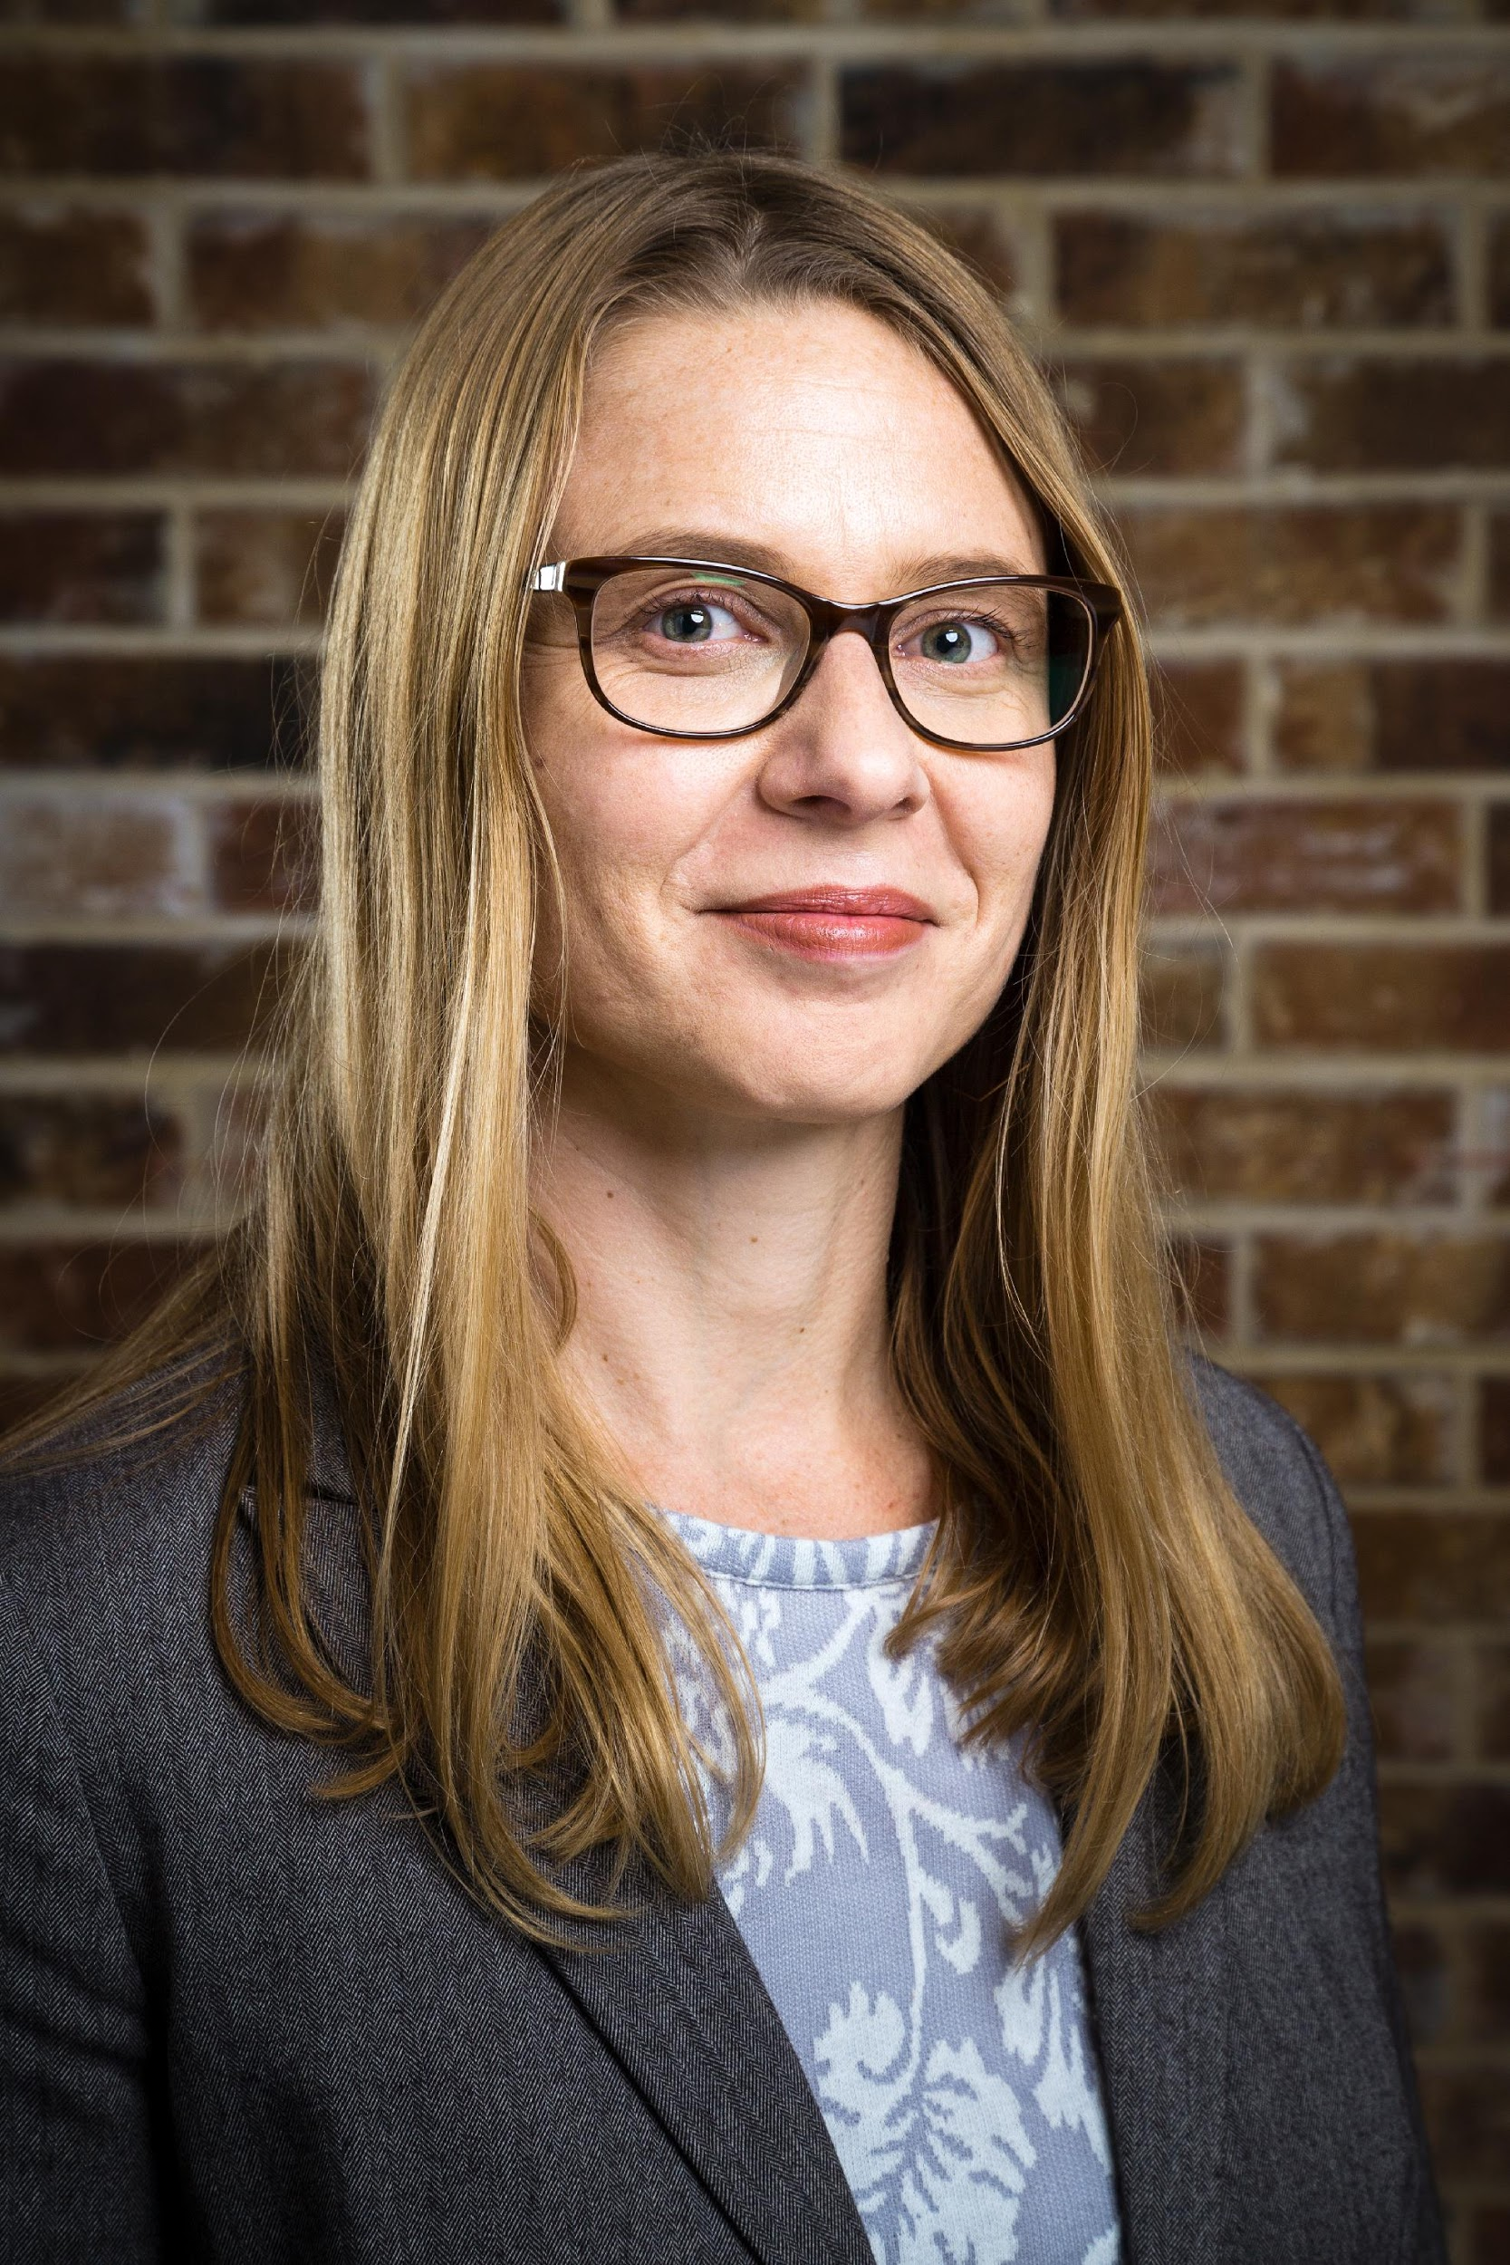
Meet the Textile Exchange benchmark team and friends.
Liesl Truscott
Sophia Opperskalski
Nicole Lambert
Simone Seisl
Vikram Shetty, 73bit
Gautam Shah, 73bit
Evonne Tan
SuetYin Siew
Stefanie Maurice
Sarina Saddiq (intern)
Cory Skuldt, FWD IMPACT
Notes:
Alongside the Textile Exchange team members
Cory Skuldt, FWD IMPACT
there is also a Steering Group advising and feeding back on the strategic review.

Slide 41
Library
─
Website https://textileexchange.org/pfm-benchmark/
PFMB Portal http://pfm.textileexchange.org/
Annual Reports
2018 – PFMB Insights Report (pdf)
2018 – Sector & Sub-Sector Feedback Report (pdf)
2018 – Sample Company Feedback Report (pdf)
2017 – PFMB Insights Report (pdf)
2016 – PFMB Sector Report (pdf)
2015 – PFMB Pilot Report (pdf)
Support Material
About the Benchmark (pdf)
PFMB Guidance Notes (under development for 2019)
PFMB Program Terminology (under development for 2019)
PFMB Technical Notes (under development for 2019)

Slide 42
Contact: Support@TextileExchange.org
─

